Slide 1


Partitioning - The Good, The Bad, And The Ugly

Slide 2
10,000ft View of Partitioning

Slide 3


What is Partitioning
Breaks very big tables into smaller parts
“Horizontal Partitioning” divides by row
Commonly by date (month or year)
“Vertical Partitioning” divides by column
Still requires a unique key to link the smaller tables
We’re going to look at horizontal partitioning

Slide 4

Benefits of Partitioning Large Tables
Faster loading of new data
Faster archiving or removal of old data
Can improve query performance (partition elimination)

Slide 5

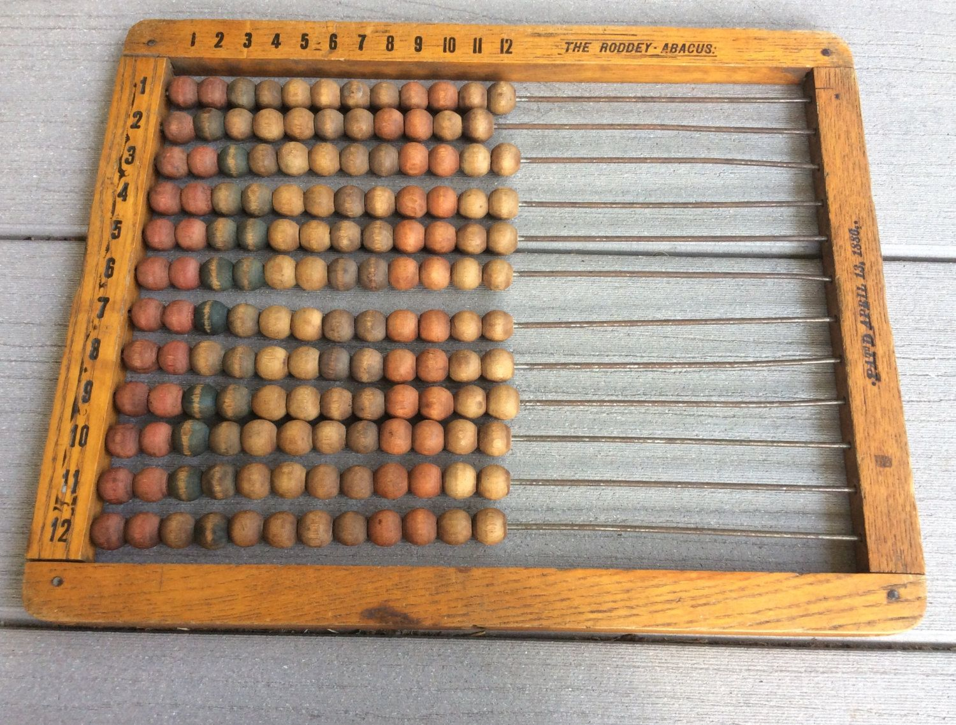
Benefits of Partitioning Large Tables
Perform index maintenance on individual partitions
Can apply different data compression
Data can physically reside in different folders or even different disks (fast expensive storage for frequent access, slow cheap storage for old data rarely accessed)

Slide 6

Gotchas
Lots of rules involved in partition switching to load or unload data
Potential to have a negative impact on performance
Adds complexity if you mix your partitioning strategies

Slide 7
Now let’s dive a little deeper

Slide 8

Concepts in Partitioning
Partition Function
This is an object that defines the number of partitions and partition boundaries for the tables and indexes that use the function
Partition Scheme
Maps the partitions to filegroups (in an index, every partition can only be linked to a single filegroup, but different partitions can link to different filegroups. Similarly, different indexes – e.g. clustered vs nonclustered)

Slide 9
Concepts in Partitioning, cont’d
Partitioning Column
The column used by the partition function to divide/partition the data in the table or index
Most commonly a date-related field, but can be almost any data type

Slide 10

Concepts in Partitioning, cont’d
Aligned Indexes
When an index is built on the same partition function as the clustered index or heap (table)
Or when different partition functions have identical metadata (number of partitions, boundary values, data type)
Enables partition switching

Slide 11

Concepts in Partitioning, cont’d
Partition Elimination
When the query optimizer can identify specific partitions to satisfy query predicate and ‘eliminate’ all the rest
This means less data to search through
Which leads to better performance
Can have negative performance impact if partitions reside on different disks and partition elimination is not used

Slide 12

Concepts in Partitioning, cont’d
Range Left
Boundary value belongs to the left side partition (good for numbers)
0...10...20
Ptn 1: <= 0
Ptn 2: > 0 <= 10
Ptn 3: > 10 <= 20
Ptn 4: > 20
Range Right
Boundary value belongs to the right side partition (good for dates)
0...10...20
Ptn 1: < 0
Ptn 2: >= 0 < 10
Ptn 3: >= 10 < 20
Ptn 4: >= 20

Slide 13

Concepts in Partitioning, cont’d
Partition Switching
Moves an entire partition between tables - subject to T&Cs...
This is a metadata-only operation, so very quick (hence rules/restrictions)
Can switch between 2 partitioned tables
Can switch from unpartitioned table into partitioned (load/ETL)
Can switch from partitioned table into unpartitioned (archiving)
Can switch data between unpartitioned tables (just plain ‘switching’)

Slide 14

Concepts in Partitioning, cont’d
Split Range
Create new partitions by adding new ranges
Can result in data movement if there is data in an existing partition that would fall under new boundary value that now defines these values
Merge Range
Removes a partition by removing the boundary value
Can result in data movement if there is existing data within the old boundary, this would be merged/moved into the boundary that now defines these values

Slide 15
Concepts in Partitioning, cont’d
Sliding Window Partitioning
Maintain the same number of partitions over time
Split new partition ranges
Merge old partition ranges
Easy to automate and monitor
Slightly more complicated when using different filegroups (incremental, round-robin set, or other rules for determining which filegroup to use

Slide 16

Partition Switching Rules
Rules, Rules, Rules
Source and target must exist before the switch (table and/or partition)
Receiving partition (or table) must be empty
Source and target must be identical (columns, data types, order, nullability)
Partitions must be on the same column (if to/from a partitioned table)
Source and target must be on the same filegroup
Source and target must have the same indexes

Slide 17
Partition Switching Rules
More Rules
Source data must match or be a subset of target partition boundaries
Check constraints must match or source range be within target range
Check constraint needed when switching from table into partition
Same FK and check constraints on source and target
Aligned index (recommend using same function for simplicity)
No foreign key can reference source table

Slide 18

Partition Switching Rules
More Rules
No replication on source or target tables by default *
No IUD triggers can are activated
No fulltext indexes on source or target
No XML indexes on source or target
Requires ALTER TABLE permission
DDL triggers are okay (alter table operation)
Notes:
* Can be enabled: https://docs.microsoft.com/en-us/sql/relational-databases/replication/publish/replicate-partitioned-tables-and-indexes?view=sql-server-ver16

Slide 19

Gotchas
Things to keep in mind
Partition switching is a metadata operation - very fast
Partition range merge or split can result in data movement and this can cause significant blocking depending on affected volume
If no boundary range exists for a record, it goes into the NULL partition

Slide 20
Gotchas
Things to keep in mind
If the partition column is NULL, data will go to partition #1 (left-most)
This could affect archiving strategy if NULL represents active/current data - now you can no longer switch out the oldest partition to be archived off!
UNLESS…
NULL is specified as a boundary value and function is range right
Then the left-most partition is empty and NULL values are placed in partition #2

Slide 21

Gotchas
Things to keep in mind
More partitions = longer overall maintenance
More partitions = longer DBCC execution time (checkdb, checktable)
BUT maintenance can be limited to individual partitions
Building non-aligned indexes requires more memory than aligned *
Non-aligned indexes can cause trouble for partition switching
Notes:
* https://docs.microsoft.com/en-us/sql/relational-databases/partitions/partitioned-tables-and-indexes?view=sql-server-ver16

Slide 22
Gotchas
Things to keep in mind
Using partition elimination on a partitioned table improves performance
But not using it can noticeably degrade performance
When joining partitioned tables, include partition key wherever possible
Stats using default sampling may not scan all partitions

Slide 23
Gotchas
Be cautious
From SQL 2016 you can truncate partitions (yay!)
TRUNCATE TABLE dbo.MyTable WITH (PARTITIONS (1, 2, 4 TO 6));
But be careful that you don’t accidentally truncate the entire table (oops…)
TRUNCATE TABLE dbo.MyTable;
You can have some partitions on readonly filegroups
Data on read-only filegroups is not updatable
Data on read/write filegroups is updatable

Slide 24
SQL Server Objects

Slide 25
DMVs
sys.partition_functions
All the functions along with metadata
sys.partition_parameters
Function parameters and data types
sys.partition_range_values
Partition ranges and boundary values
sys.partition_schemes
Partition schemes and the link to partition function

Slide 26
DMVs
sys.partitions
Actual partitions of each index (even unpartitioned indexes will have 1 partition here
sys.destination_data_spaces
Link between partition scheme and filegroup per partition
sys.filegroups
All filegroups in the DB
sys.dm_db_partition_stats
Partition stats including: reserved and used page counts, row counts, lob vs in row

Slide 27
DMFs
sys.dm_db_index_physical_stats (DB, Object, Index, Partition, Mode)
Partition-level physical stats
Pages
Fragmentation

Slide 28

Credits
Colin McNamee for fact-checking and providing amazing imagery ideas!!
And all the amazing blogs and online resources out there (see next slide for references)

Slide 29
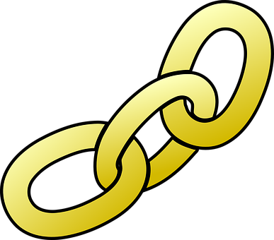
Links
Partitioning on replicated tables:
https://docs.microsoft.com/en-us/sql/relational-databases/replication/publish/replicate-partitioned-tables-and-indexes?view=sql-server-ver16
General partition switching requirements and rules:
https://www.cathrinewilhelmsen.net/table-partitioning-in-sql-server-partition-switching/
https://docs.microsoft.com/en-us/sql/relational-databases/partitions/partitioned-tables-and-indexes?view=sql-server-ver16
https://www.brentozar.com/sql/table-partitioning-resources/
https://dbafromthecold.com/2014/06/04/partitioning-basics-part-1/
https://dbafromthecold.com/2018/02/21/indexing-and-partitioning/

Slide 30
Contact Info
Name: Angela Kruger
Email: sqlmarathons@gmail.com
LinkedIn: https://www.linkedin.com/in/angela-kruger-a108752a

